Slide 1

TECHNOLOGICAL INSTITUTE OF THE PHILIPPINES
College of Information Technology Education
Introduction to C++ Programming Language

Slide 2
Intended Learning Outcomes (ILOs)
At the end of the lesson the students should be able to:
Value the historical development of computer programming
Understand the definition of C++ Programming language.

Slide 3
Who Should Learn C++?
You don’t need any previous experience in programming to learn C++ with this course.
It starts with the basics and teaches you both the language and the concepts involved with programming C++.
Whether you are just beginning or already have some experience programming, you will find that this course makes learning C++ fast and easy.

Slide 4
Why Should I Learn C++?
You could be learning a lot of other languages, but C++ is valuable to learn because it has stood the test of time and continues to be a popular choice for modern programming.
Despite being created in 1979, C++ is still being used for professional software today because of the power and flexibility of the language.

Slide 5
Learning C++ Program
As your objective is to learn the C++ programming language, two questions naturally arise.
What is a computer program?
A computer or a program is a sequence of statements whose objectives is to accomplish a task.
(2)What is programming?
Programming is a process of planning and creating a program.

Slide 6
History of C++ ( C with Classes)
C++ is a portable language that works equally well on Microsoft Windows, Apple Mac OS, Linux and Unix systems which was developed by Bjarne Stroustrup (B-yar-ne Strov-stroop)
Stroustrup C++ creation has held a spot among the world’s top programming languages for decades and still remains a contemporary and useful choice for software development on desktop computers, servers, embedded devices like phones and many other computing environments.
Originally, it was designed as an improvement upon the C programming, which was developed by Bell Labs.

Slide 7
History of C++ ( C with Classes)
Developed in the early 1970s, C’s name is derived from the B programming language, which in turn was derived from the BCPL language.
C gained a large following, in part due to its use in the development of the UNIX operating system. Due to both its popularity and the number of versions on the market, an American National Standards Institute (ANSI) committee was formed in 1982 to create a standard for the C language, which was adopted in 1989.
Stroustrup began with the idea that object-oriented programming would be an important addition to C, and created C with Classes.
In 1983, Stroustrup’s contributions officially became known as C++, its name stemming from C and adding the ++ (increment) operator.
It was not until 1998 that the international standard for C++ was established.

Slide 8
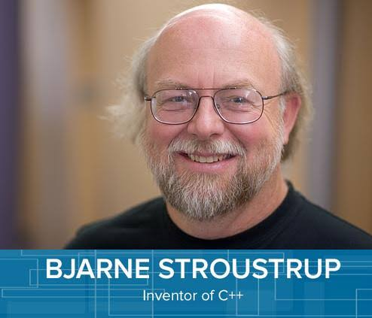
About the C++ Developer
Bjarne Stroustrup (B-yar-ne Strov-stroop), a Danish computer scientist at Bell Labs in the United States
Born on December 30, 1950
He is a visiting professor at Columbia University, and works at Morgan Stanley as a Managing Director in New York
He received a master's in mathematics from Aarhus University in 1975 and a PhD in computer science from Cambridge University in 1979.

Slide 9
History of Programming Language
YEAR1983 | Programming Language | DEVELOPER | LOCATION
1963 | CPL-Combined Programming Language | Members of University Mathematical of London & Cambridge | Cambridge University
1967 | BCPL -Basic Combined Programming Language | Martin Richards | Cambridge University
1958-68 | ALGOL - Algorithmic Language (Algol 58) | John Backus | Europe & US
 | ALGOL - Algorithmic Language (Algol 60) | Peter Naur | Europe & US
 | ALGOL - Algorithmic Language (Algol 68) | Van Wijngaarden | Europe & US
1970 | B | Ken Thompson | Bell Laboratory, US
1972 | C | Dennis Ritchie | Bell Laboratory, US
1979/80 1983 | C++ -start developing C++ officially knowns as C++ | Bjarne Stroustrup | AT & T, US

Slide 10
What is C++?
C++ is based on C and it retains much of that language, including a rich operator set.
C++ is a highly portable language, and translators for it exist on many different machines and systems.
C++ compilers are highly compatible with the existing C programs because maintaining such compatibility was a design objective.
Programming in C++ does not require a graphics environment, and C++ programs do not incur runtime expense from type checking or garbage collection.
C++ has improved on C in significant ways, especially in supporting strong typing.

Slide 11
What is C++?
The class syntax was added to the language which was an extension of the struct construct in C.
C++ is superior than C in supporting object-oriented programming. C++ may even replace C in becoming a general purpose programming language.
C++ program is a collection of functions.
Every C++ program has a function called main.

